Slide 1

Identity & Access Management
201
Presentation by:
S.Suresh
CloudSIKSHA

Slide 2
IAM
Identity and Access Management
Authentication
Login, Keys
MFA
Authorization
Policies
Roles

Slide 3

Authentication
Login and Password for console user
MFA for additional protection
Access Key & Secret Access Key for APIs
  CLI
  SDK
Federation using SAML 2.0
Web Identity Federation
AWS Single Sign On (SSO)

Slide 4

Authorization
Policies
  Role Based Access Control
  Attribute Based Access Control
Roles

Slide 5

Policies
Identity Based Policies
  Attached to IAM User
Resource Based Policies
  Attached to the Resource
IAM Permission boundaries
  Maximum permissions that an identity-based policy can grant to an IAM entity
Organization Service Control Policy (SCP)
Session Policies

Slide 6
Identity Based Policies
Identity-based policies are JSON permissions policy documents that control what actions an identity (users, groups of users, and roles) can perform, on which resources, and under what conditions.
Managed Policies
  AWS Managed
  Customer Managed
Inline Policies
  Policies that you add directly to a single user, group, or role
  Inline policies maintain a strict one-to-one relationship between a policy and an identity
  They are deleted when you delete the identity

Slide 7
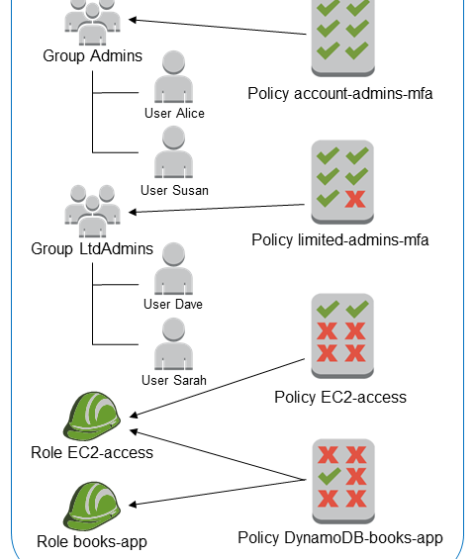
Customer Managed Policies

Slide 8
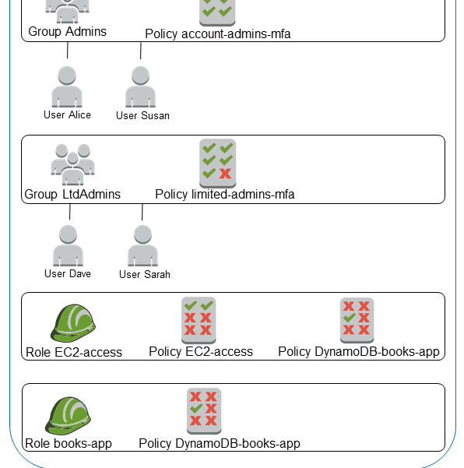
Inline Policies

Slide 9

Resource Based Policies
Resource-based policies are JSON policy documents that you attach to a resource such as an Amazon S3 bucket
These policies grant the specified principal permission to perform specific actions on that resource and defines under what conditions this applies
Resource-based policies are inline policies. There are no managed resource-based policies

Slide 10

IAM Permission Boundaries
A permissions boundary is an advanced feature in which you set the maximum permissions that an identity-based policy can grant to an IAM entity
When you set a permissions boundary for an entity, the entity can perform only the actions that are allowed by both its identity-based policies and its permissions boundaries

Slide 11

Service Control Policies
AWS Organizations is a service for grouping and centrally managing the AWS accounts that your business owns
If you enable all features in an organization, then you can apply service control policies (SCPs) to any or all of your accounts. SCPs are JSON policies that specify the maximum permissions for an organization or organizational unit (OU)
The SCP limits permissions for entities in member accounts, including each AWS account root user

Slide 12

Session Policies
Session policies are advanced policies that you pass in a parameter when you programmatically create a temporary session for a role or federated user
The permissions for a session are the intersection of the identity-based policies for the IAM entity (user or role) used to create the session and the session policies

Slide 13
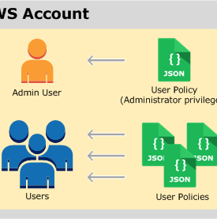
User Policies

Slide 14
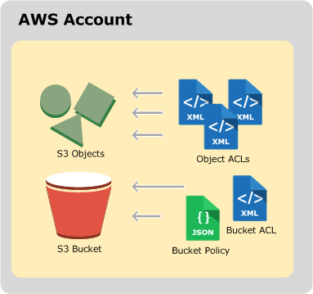
Resource based policies

Slide 15
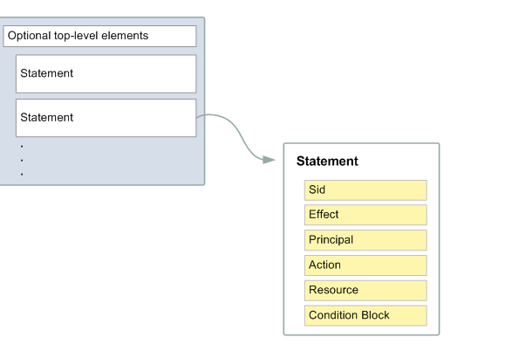
JSON Policy Document Structure

Slide 16
An example bucket policy
Bucket Policy is a JSON file
{
"Version":"2012-10-17",
"Statement": [
{
"Effect":"Allow",
"Principal": "*",
"Action":["s3:GetObject"],
"Resource":["arn:aws:s3:::examplebucket/*"]
}
]
}
Reference: Amazon S3 manual

Slide 17
An example of user policy
{
"Statement": [
{
"Effect":"Allow",
"Action": [
"s3:PutObject",
"s3:GetObject",
"s3:DeleteObject",
"s3:ListAllMyBuckets",
"s3:GetBucketLocation",
"s3:ListBucket"
],
"Resource":"arn:aws:s3:::examplebucket/*"
}
]
}
Reference: Amazon S3 manual

Slide 18
Condition Checking
{
"Version": "2012-10-17",
"Id": "S3PolicyId1",
"Statement": [
{
"Sid": "IPAllow",
"Effect": "Allow",
"Principal": "*",
"Action": "s3:*",
"Resource": "arn:aws:s3:::examplebucket/*",
"Condition": {
"IpAddress": {"aws:SourceIp": "54.240.143.0/24"},
"NotIpAddress": {"aws:SourceIp": "54.240.143.188/32"}

Slide 19
An example
{
"Version": "2012-10-17",
"Statement": [
{
"Sid": "ExampleStatement1",
"Effect": "Allow",
"Principal": {
"AWS": "arn:aws:iam::Account-ID:user/Dave"
},
"Action": [
"s3:GetBucketLocation",
"s3:ListBucket",
"s3:GetObject"
],
"Resource": [
"arn:aws:s3:::examplebucket"
]
}
]
}

Slide 20

JSON Policy Element
Version
The Version policy element specifies the language syntax rules that are to be used to process a policy
2012-10-17 is the current version of the policy language
ID
The Id element specifies an optional identifier for the policy
Statement
The Statement element is the main element for a policy. Mandatory
The Statement element can contain a single statement or an array of individual statements.

Slide 21
JSON Policy Elements
Sid
The Sid (statement ID) is an optional identifier that you provide for the policy statement
Effect
The Effect element is required and specifies whether the statement results in an allow or an explicit deny
Principal
Use the Principal element in a policy to specify the principal that is allowed or denied access to a resource
Cannot be used in Identity Based policies

Slide 22
JSON Policy Elements
NotPrincipal
NotPrincipal element specifies the IAM user, federated user, IAM role, AWS account, AWS service, or other principal that is not allowed or denied access to a resource
Action
The Action element describes the specific action or actions that will be allowed or denied
NotAction
NotAction is an advanced policy element that explicitly matches everything except the specified list of actions

Slide 23

JSON Policy Element
Resource
The Resource element specifies the object or objects that the statement covers
NotResource
NotResource is an advanced policy element that explicitly matches every resource except those specified
Condition
The Condition element (or Condition block) lets you specify conditions for when a policy is in effect
Optional

Slide 24
NotPrincipal example
{
"Version": "2012-10-17",
"Statement": [{
"Effect": "Deny",
"NotPrincipal": {"AWS": [
"arn:aws:iam::444455556666:user/Bob",
"arn:aws:iam::444455556666:root"
]},
"Action": "s3:*",
"Resource": [
"arn:aws:s3:::BUCKETNAME",
"arn:aws:s3:::BUCKETNAME/*"
]
}]
}

Slide 25
NotAction Example
{
"Version": "2012-10-17",
"Statement": [{
"Sid": "DenyAllUsersNotUsingMFA",
"Effect": "Deny",
"NotAction": "iam:*",
"Resource": "*",
"Condition": {"BoolIfExists": {"aws:MultiFactorAuthPresent": "false"}}
}]
}

Slide 26
NotResource Example
"Version": "2012-10-17",
"{
Statement": [{
"Effect": "Deny",
"Action": "s3:*",
"NotResource": [
"arn:aws:s3:::HRBucket/Payroll",
"arn:aws:s3:::HRBucket/Payroll/*"
]
}
}

Slide 27
Not Action Example
{
"Effect": "Deny",
"NotAction": [
"cloudfront:*",
"iam:*",
"route53:*",
],
"Resource": "*",
"Condition": {
"StringNotEquals": {
"aws:RequestedRegion": [
"eu-central-1",
]

Slide 28

Attribute Based Access Control (ABAC)
Attribute-based access control (ABAC) is an authorization strategy that defines permissions based on attributes
  These attributes are called tags
  Attach tags to Principal and Resource
  Grant permission to Principal based on tags
  Much more flexible than the traditional access control

Slide 29
ABAC Example
{
"Version": "2012-10-17",
"Statement": [
{
"Sid": "AllActionsSecretsManagerSameProjectSameTeam",
"Effect": "Allow",
"Action": “s3:*",
"Resource": "*",
"Condition": {
"StringEquals": {
"aws:ResourceTag/access-project": "${aws:PrincipalTag/access-project}",
"aws:ResourceTag/access-team": "${aws:PrincipalTag/access-team}",
"aws:ResourceTag/cost-center": "${aws:PrincipalTag/cost-center}"
},

Slide 30
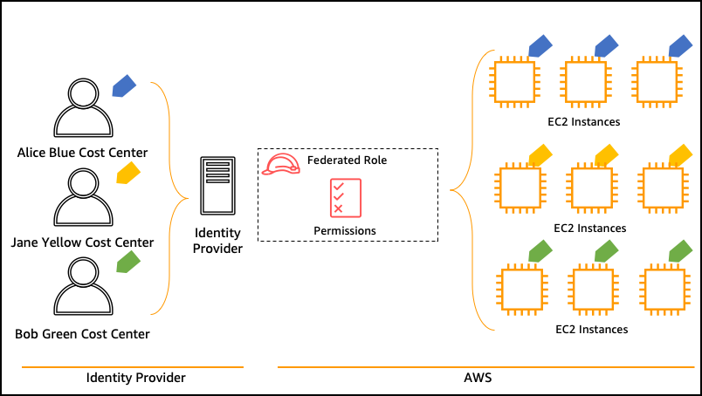
ABAC Example

Slide 31
Evaluating Request Context
Actions (or operations)
Resources
Principal
Environment data
Resource data

Slide 32
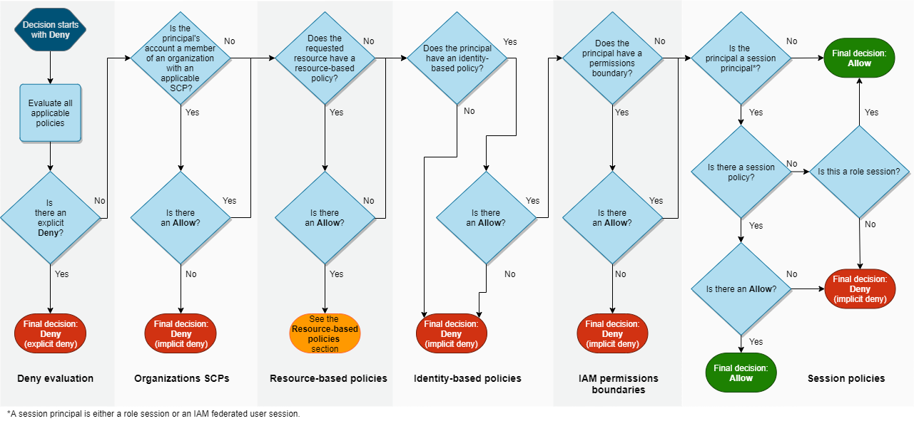
Determining Whether a Request Is Allowed or Denied Within an Account

Slide 33
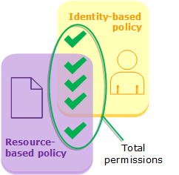
Evaluating Identity-Based Policies with Resource-Based Policies

Slide 34
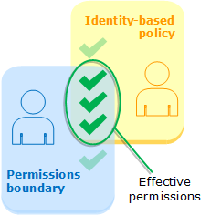
Evaluating Identity-Based Policies with Permissions Boundaries

Slide 35
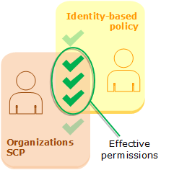
Evaluating Identity-Based Policies with Organizations SCPs

Slide 36
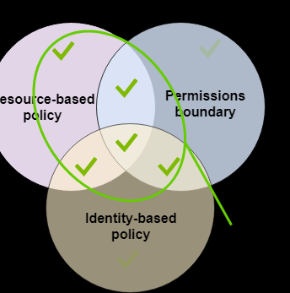
Evaluating Effective Permissions with Boundaries - Resource Policies

Slide 37
IAM Roles
When using CLI or SDK require to store Access keys in the system
Not a good practice if keys need to be stored in EC2 instance or on a mobile phone
Roles allow access without need to store keys
Roles allow us to attach policies to various AWS Services
EC2
Lambda etc
Roles are one of the security related best practices in AWS

Slide 38

Thank you

